Slide 1
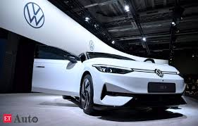
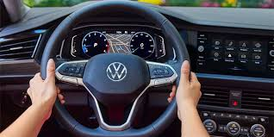
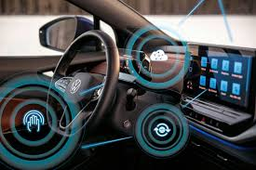
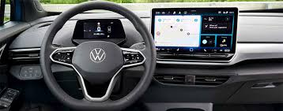
AI-Based Predictive Maintenance Platform
Problem Statement:
Traditional vehicle maintenance methods rely heavily on reactive approaches or sensor-based data collection, which can be costly and difficult to implement in every vehicle.
Many users and OEMs lack an easy-to-use solution that predicts vehicle maintenance needs without requiring additional hardware, leading to unexpected breakdowns and higher costs.
Proposed Solution:
The proposed solution is an AI-powered predictive maintenance platform that leverages the power of ML models and analyze user-inputted data (mileage, service history, driving conditions) and external APIs (weather, traffic) to predict part failures and optimize maintenance schedules and requirements.
It provides insights into the vehicle's health and sends personalized maintenance alerts.

Slide 2

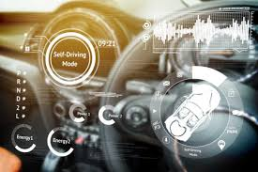
Key Features and Advantages
Real-Time Data Integration
External data like weather and traffic conditions affect vehicle maintenance, improving prediction accuracy.
User Feedback Loop
Users can report the accuracy of predictions, enabling continuous model improvements.
Cost and Time Estimation
Provides users with cost and time estimates for potential repairs or part replacements based on data.
Customizable Alerts
Users can choose which parts to monitor and set personalized thresholds for maintenance alerts.
AI Chatbot for Maintenance Queries
An intelligent chatbot answers users' maintenance questions and offers recommendations.
Advantages:
Cost-effective
Accurate
User-friendly

